Slide 1
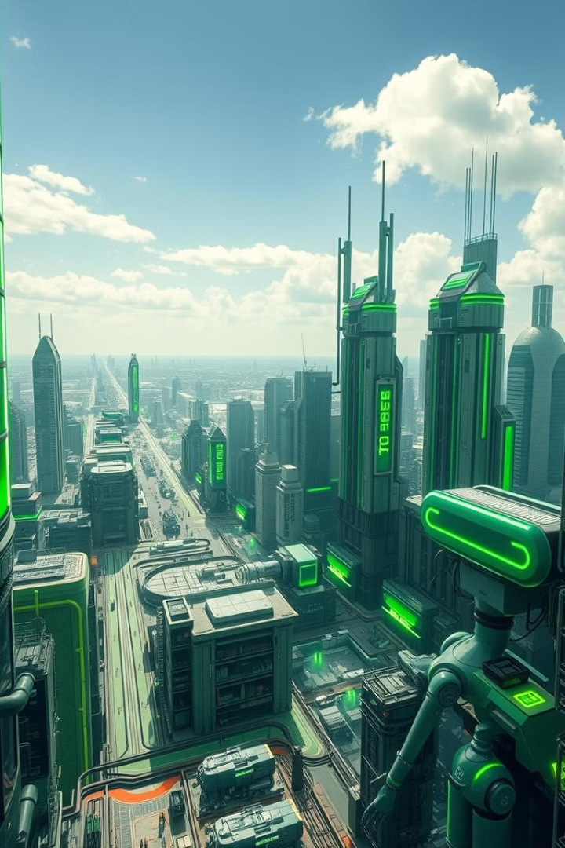
AI-Based Waste Management System
h
Team Members-
Dhruv Rajvanshi
Ayush Kumar Pathak
Parth Yaduvanshi

Slide 2

Aim and Objectives
1
1. Efficient Classification
2
2. Sustainable Practices
Develop an AI system to accurately classify waste into categories, improving recycling rates and reducing landfill waste.
Promote sustainable waste management by using AI to optimize waste collection routes and reduce transportation costs.
3
3. Data-Driven Insights
Gain valuable insights from collected data to identify trends and improve waste management strategies.

Slide 3
Introduction to Waste Management Challenges
Environmental Impact
Economic Costs
Public Health Concerns
Waste management is expensive, with significant costs associated with collection, processing, and disposal.
Landfill capacity is limited, and waste disposal releases harmful greenhouse gases.
Improper waste management can lead to pollution and disease, impacting public health.

Slide 4




Overview of Convolutional Neural Networks (CNNs)
Artificial Neural Networks
Feature Extraction
Image Classification
CNNs excel at extracting features from images, identifying patterns like edges, shapes, and textures.
Inspired by the human brain, CNNs use interconnected nodes to learn complex patterns.
By analyzing extracted features, CNNs can accurately classify images into predefined categories.

Slide 5



Datasets and Preprocessing for Waste Classification
Data Collection
1
Gather diverse images of waste from various sources, ensuring a balanced dataset.
Data Augmentation
2
Increase the size of the dataset by creating variations of existing images to improve model generalization.
Preprocessing
3
Clean and prepare the images for training by resizing, normalizing, and enhancing them.

Slide 6
CNN Architecture Design for Waste Classification
Convolutional Layers
1
Extract features from images by applying filters that identify patterns.
Pooling Layers
2
Reduce the dimensionality of feature maps, improving computational efficiency.
Fully Connected Layers
3
Connect all neurons in previous layers, enabling the network to make final classifications.
Output Layer
4
Predicts the probability of an image belonging to each waste category.

Slide 7

Training and Validation of the CNN Model
1
Train the model on the prepared dataset, adjusting weights to minimize classification errors.
2
Regularly evaluate the model's performance on a separate validation set to prevent overfitting.
3
Fine-tune hyperparameters, such as learning rate and batch size, to optimize model performance.

Slide 8
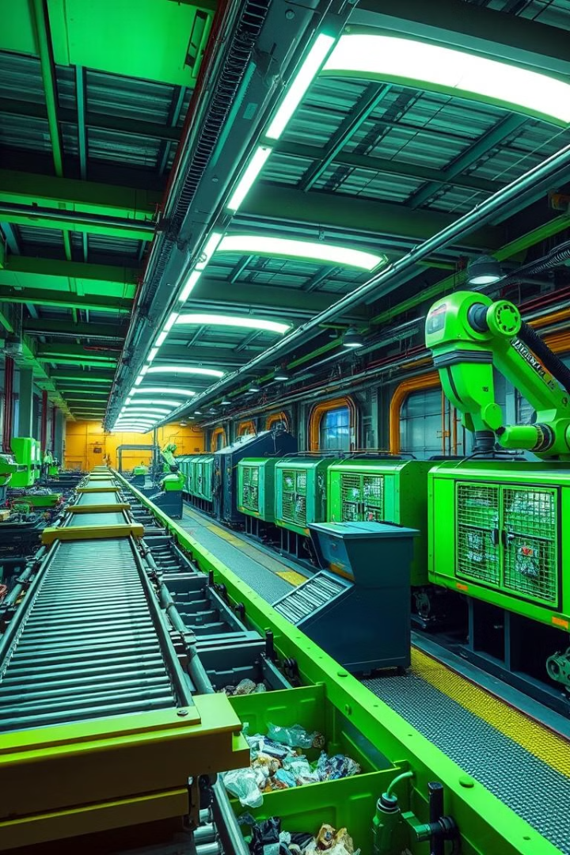



Deployment and Integration of the AI System
Deploy the trained CNN model on a suitable platform, such as a cloud server or local machine.
Integrate the AI system with existing waste management infrastructure, such as sorting facilities or smart bins.
Provide user-friendly interfaces for interacting with the AI system, allowing for data input and result visualization.

Slide 9

Quantitative and Qualitative Evaluation of the System
95%
10%
15%
Accuracy
Recycling Increase
Cost Reduction
Measure the model's accuracy in classifying waste correctly.
Evaluate the impact of the AI system on recycling rates.
Quantify the savings achieved through optimized waste management practices.

Slide 10

Conclusions-
Enhanced Efficiency and Automation: AI-powered waste management systems enable real-time monitoring, intelligent sorting, and optimized collection routes, leading to significant improvements in efficiency and cost savings.
Environmental Impact Reduction: Through advanced data analytics and predictive algorithms, AI helps minimize waste generation, maximize recycling, and reduce landfill usage, contributing to a cleaner, more sustainable environment.
Scalability and Future Innovation: AI-based waste management systems offer scalable solutions that can be easily adapted to different regions and urban scales, paving the way for continued innovation in waste processing, recycling technologies, and smart city integrations.
THANK YOUU

